Slide 1
In-class Exercise 12 - Hough
Dhiren Gupta
-800902466

Slide 2

Input image

Slide 3
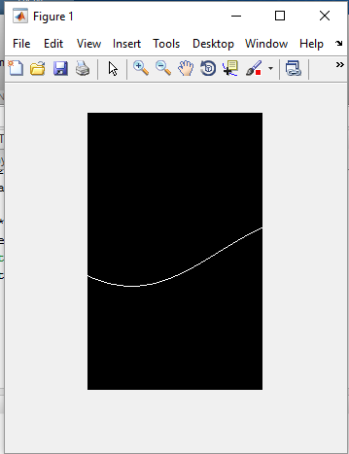
With edge pixel at[25,25]

Slide 4

Accumulator with all edge pixel

Slide 5
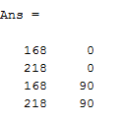
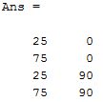
Correct locations in accumulator array with highest votes
Correct conversions to the theta and rho of those places with highest votes

Slide 6
Thank You

